Slide 1


Superintendent Thompson
(978) 345-3200 ext. 27501
thompsonj@fitchburg.k12.ma.us

Slide 2
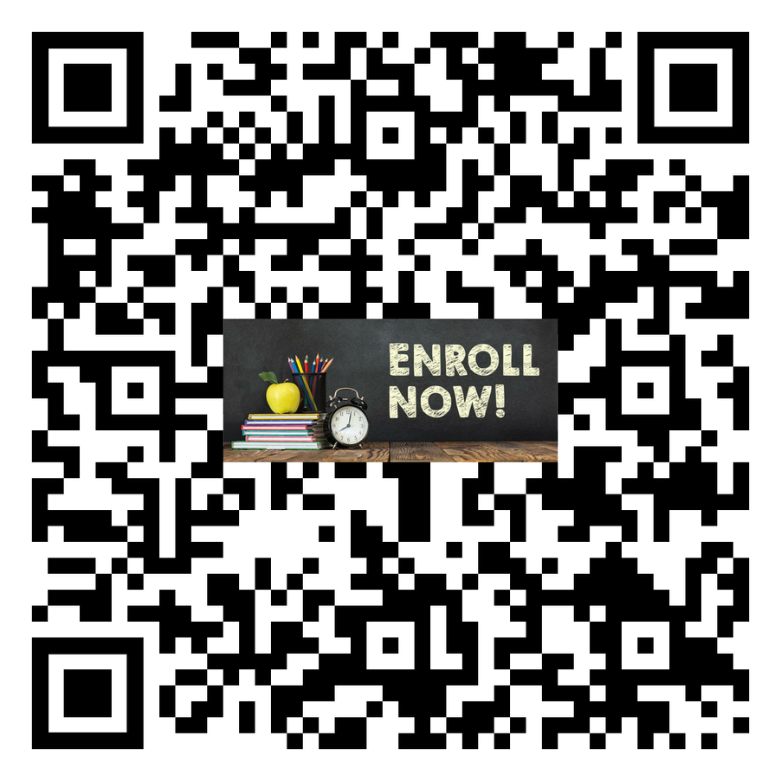
Enrollment
https://rb.gy/qgsueg

Slide 3

Preschool
https://rb.gy/pmfovf
Laura Douglas - douglasl@fitchburg.k12.ma.us

Slide 4
School Start Dates
Grades 1 - 12 : Sept. 4
Grades PK - K : Sept. 9

Slide 5
Elementary School Start Times
Crocker Elementary School
McKay Elementary School
Reingold Elementary School
9:05 AM - 3:25 PM
Early Release : 1:05 PM

Slide 6
Middle School Start Times
Longsjo Middle School : 8:05 AM - 2:25 PM
Early Release : 12:05 PM
Memorial Middle School : 7:30 AM - 1:50 PM
Early Release : 11:30 AM

Slide 7
High School Start Times
Fitchburg High School : 7:30 AM - 2:05 PM
Early Release : 11:30 AM
FSU Program : 9:00 AM - 2:00 PM
Early Release 11:40 AM
Goodrich Academy : 12:15 PM - 7:25 PM

Slide 8
South Street Early Learning Center School Start Times
Preschool Morning Session : 8:00 AM - 10:30 AM
Preschool Afternoon Session : 11:30 AM - 2:00 PM
Kindergarten : 8:20 AM - 2:40 PM
Early Release : 12:20 PM

Slide 9
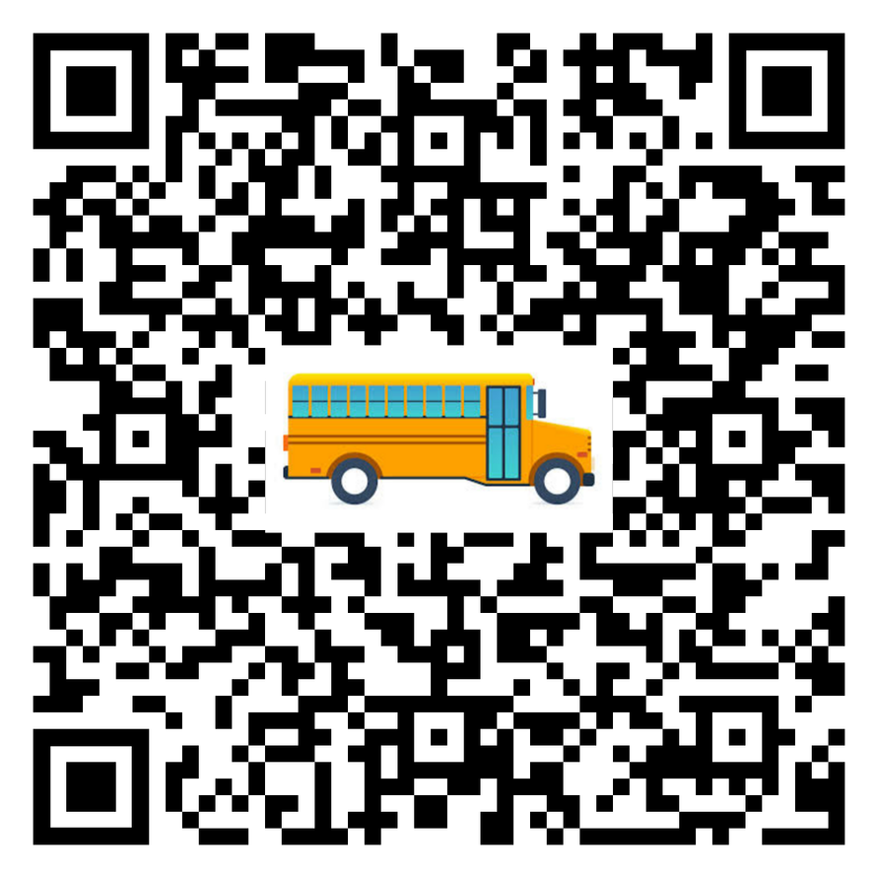
Transportation
https://rb.gy/cnp7yq
Donna Hildreth - hildrethd@fitchburg.k12.ma.us

Slide 10

Special Education
https://rb.gy/8ipfi7

Slide 11
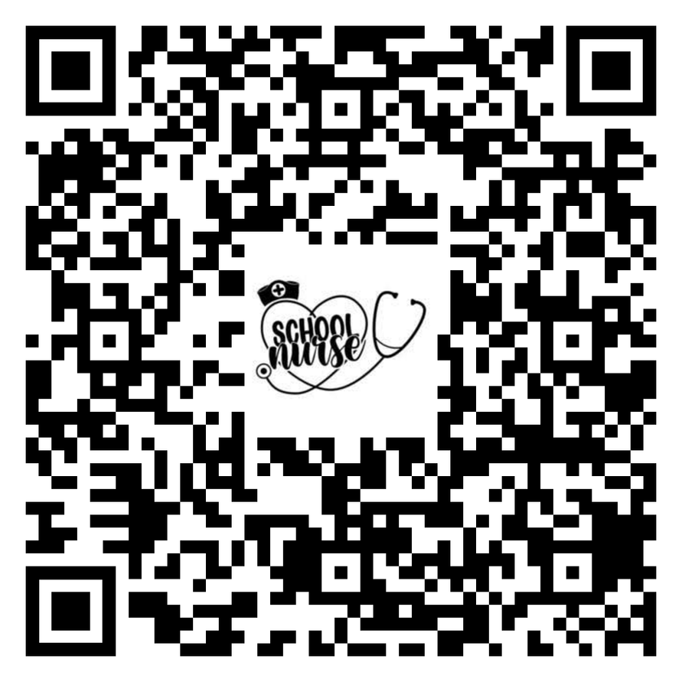
Health Services
https://rb.gy/49nqlq
Pamela Rivers - riversp@fitchburg.k12.ma.us

Slide 12
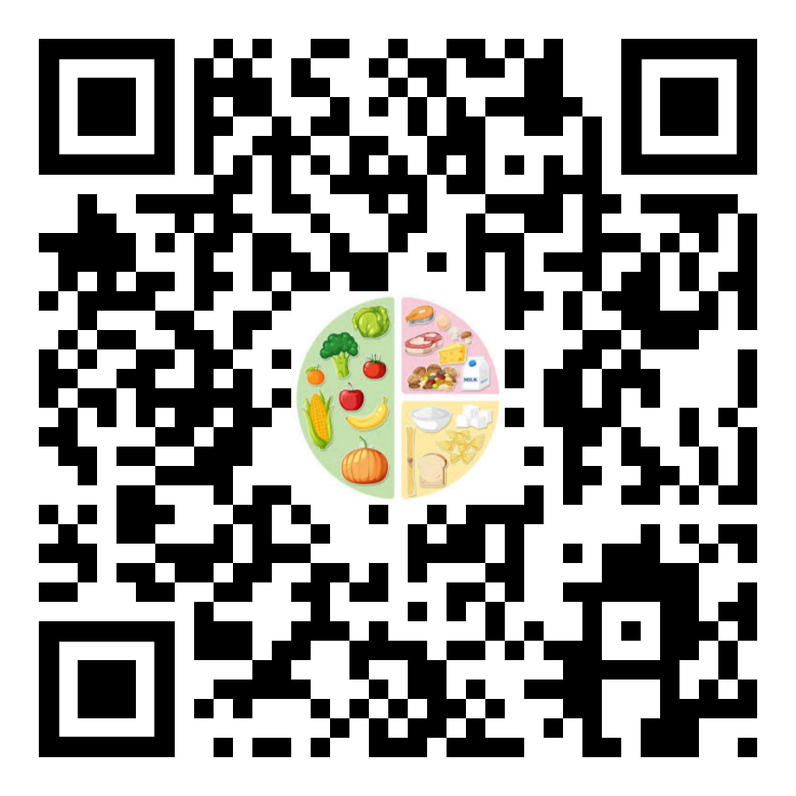
Nutrition Services
https://rb.gy/4n82y2
David Semenza - semenzad@fitchburg.k12.ma.us

Slide 13

21st Century
https://rb.gy/1ogmlv
John Marderosian - marderosianj@fitchburg.k12.ma.us

Slide 14
Superintendent Office Hours
Sept. 4th
4:00 PM - 6:00 PM
Sept. 16th
8:00 AM - 10:00 AM
molinam@fitchburg.k12.ma.us to set an appointment

